Slide 1
Storage devices we use everyday

Slide 2
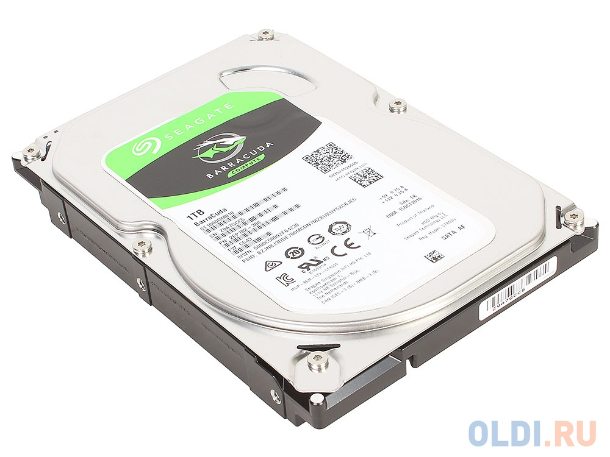
Hard drive
A hard disk drive (also known as a hard drive, HD, or HDD) can be found installed in almost every desktop computer and laptop. It stores files for the operating system and software programs, as well as user documents, such as photographs, text files, and audio. The hard drive uses magnetic storage to record and retrieve digital information to and from one or more fast-spinning disks.

Slide 3
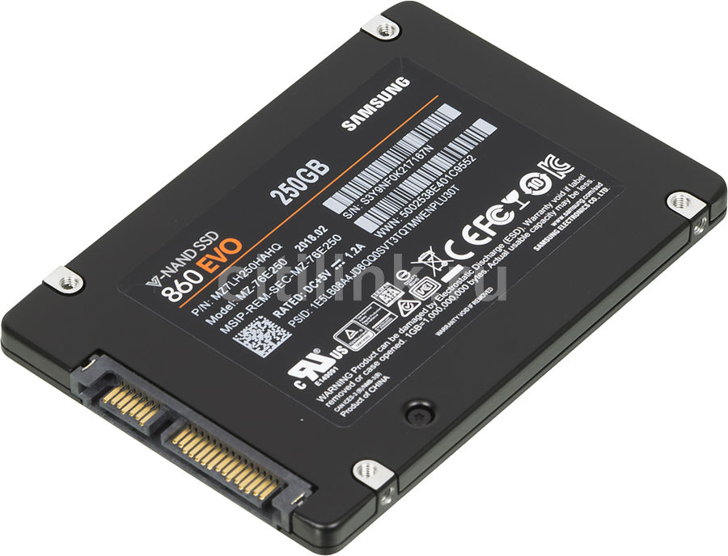
SSD
A solid state drive uses flash memory to store data and is sometimes used in devices such as netbooks, laptop, and desktop computers instead of a traditional hard disk drive. The advantages of an SSD over a HDD include a faster read/write speed, noiseless operation, greater reliability, and lower power consumption. The biggest downside is cost, with an SSD offering lower capacity than an equivalently priced HDD.

Slide 4
Compact Disc (CD)
The compact disc, known for short as a CD, is a form of optical storage, a technology which employs lasers and lights to read and write data. Initially compact discs were used purely for music audio, but in the late 1980's they began to be also used for computer data storage. Initially, the compact discs that were introduced were CD-ROM's (read only), but this was followed by CD-R's (writable compact discs) and CD-RW's (re-writable compact discs).

Slide 5
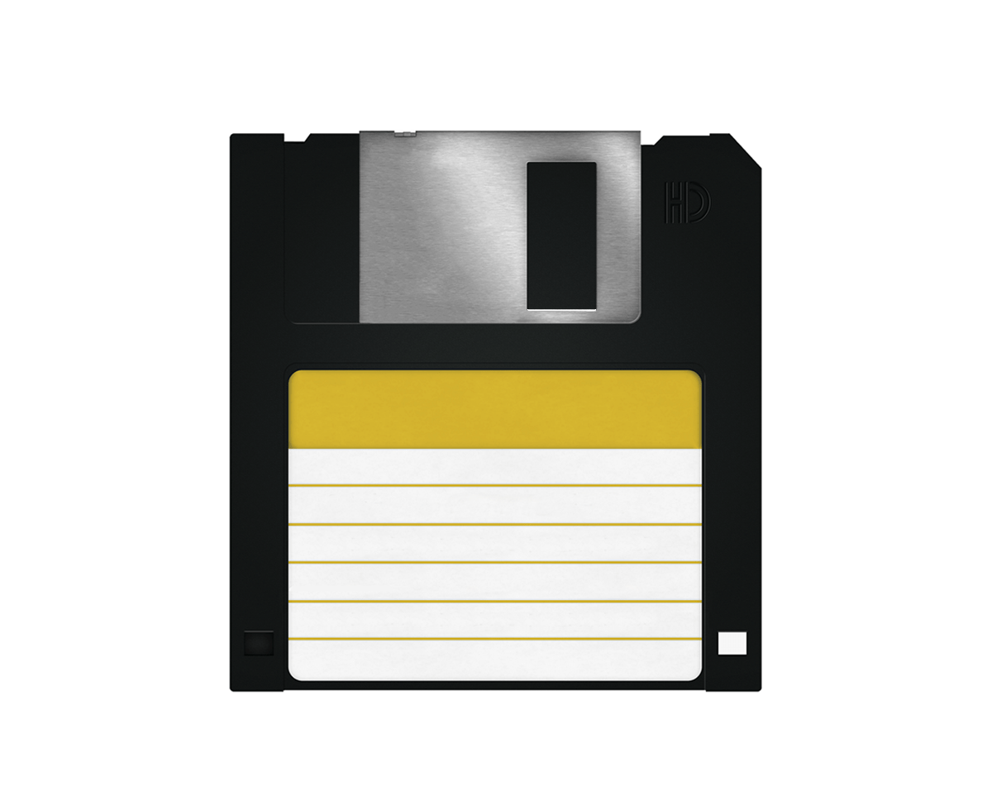
Floppy disk
A floppy disk, also known as a floppy, diskette, or simply disk, is a type of disk storage composed of a disk of thin and flexible magnetic storage medium, sealed in a rectangular plastic enclosure lined with fabric that removes dust particles. Floppy disks are read and written by a floppy disk drive (FDD).
Floppy disks, initially as 8-inch (203 mm) media^{[1]} and later in 5 ¹⁄₄-inch (133 mm) and ​3 ¹⁄₂ inch (90 mm) sizes, were a ubiquitous form of data storage and exchange from the mid-1970s into the first years of the 21st century.^{[2]} By 2006, computers were rarely manufactured with installed floppy disk drives; ​3 ¹⁄₂-inch floppy disks can be used with an external USB floppy disk drive, but USB drives for ​5 ¹⁄₄-inch, 8-inch, and non-standard diskettes are rare to non-existent. These formats are usually handled by older equipment.

Slide 6
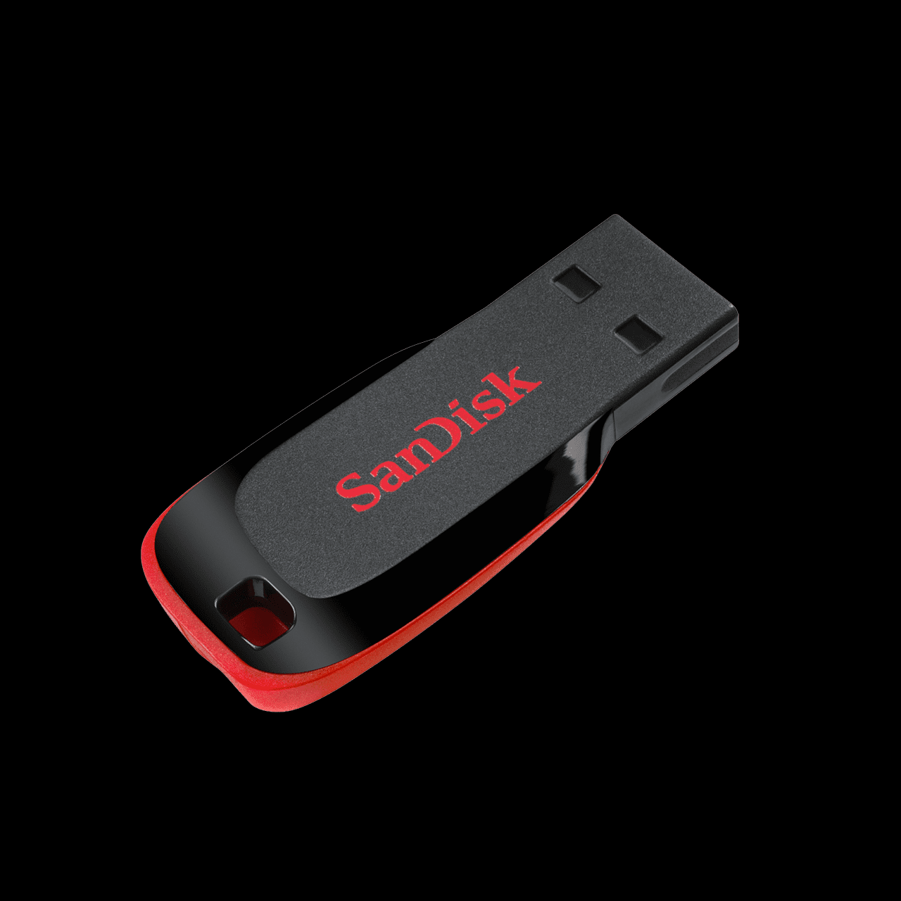
Flash drive
A USB flash drive[note 1] is a data storage device that includes flash memory with an integrated USB interface. It is typically removable, rewritable and much smaller than an optical disc. Most weigh less than 30 g (1 oz). Since first appearing on the market in late 2000, as with virtually all other computer memory devices, storage capacities have risen while prices have dropped. As of March 2016, flash drives with anywhere from 8 to 256 gigabytes (GB[2]) were frequently sold, while 512 GB and 1 terabyte (TB[3]) units were less frequent.[4][5] As of 2018, 2 TB flash drives were the largest available in terms of storage capacity.[6] Some allow up to 100,000 write/erase cycles, depending on the exact type of memory chip used, and are thought to last between 10 and 100 years under normal circumstances (shelf storage time[7]).

Slide 7
DVD disk
DVD (acronym for Digital Versatile Disc or Digital Video Disc)[8][9] is a digital optical disc storage format invented and developed in 1995 and released in late 1996. The medium can store any kind of digital data and is widely used for software and other computer files as well as video programs watched using DVD players. DVDs offer higher storage capacity than compact discs while having the same dimensions.
Prerecorded DVDs are mass-produced using molding machines that physically stamp data onto the DVD. Such discs are a form of DVD-ROM because data can only be read and not written or erased. Blank recordable DVD discs (DVD-R and DVD+R) can be recorded once using a DVD recorder and then function as a DVD-ROM. Rewritable DVDs (DVD-RW, DVD+RW, and DVD-RAM) can be recorded and erased many times.

Slide 8
DVD
Secure Digital, officially abbreviated as SD, is a proprietary non-volatile memory card format developed by the SD Card Association (SDA) for use in portable devices.
The standard was introduced in August 1999 by joint efforts between SanDisk, Panasonic (Matsushita Electric) and Toshiba as an improvement over MultiMediaCards (MMC),[1] and has become the industry standard. The three companies formed SD-3C, LLC, a company that licenses and enforces intellectual property rights associated with SD memory cards and SD host and ancillary products.[2]
The companies also formed the SD Association (SDA), a non-profit organization, in January 2000 to promote and create SD Card standards.[3] SDA today has about 1,000 member companies. The SDA uses several trademarked logos owned and licensed by SD-3C to enforce compliance with its specifications and assure users of compatibility.[

Slide 9
SD card
Secure Digital, officially abbreviated as SD, is a proprietary non-volatile memory card format developed by the SD Card Association (SDA) for use in portable devices.
The standard was introduced in August 1999 by joint efforts between SanDisk, Panasonic (Matsushita Electric) and Toshiba as an improvement over MultiMediaCards (MMC),^{[1]} and has become the industry standard. The three companies formed SD-3C, LLC, a company that licenses and enforces intellectual property rights associated with SD memory cards and SD host and ancillary products.^{[2]}
The companies also formed the SD Association (SDA), a non-profit organization, in January 2000 to promote and create SD Card standards.^{[3]} SDA today has about 1,000 member companies. The SDA uses several trademarked logos owned and licensed by SD-3C to enforce compliance with its specifications and assure users of compatibility.

Slide 10
Thanks!

